Slide 1
Cellular Automata for Cloud Resource Allocation
Koushik Ragavendran
st169478@stud.uni-stuttgart.de

Slide 2
Overview
Introduction
Modelling and Simulation
Optimization Algorithm
Rule 23 and Rule 232
Wolfram classification
Result
Conclusion
Future Work
References

Slide 3
Introduction
Cellular Automata:
A cell on grid that represents a state of a instance in a system is called as Cellular Automata. Collection of Cellular Automata is called as Cellular Automaton.
Cellular Automata can be used to represent complex systems.
State of the Cellular Automata can be evolved as a function of state of itself and its neighbours from previous generation. The function can be defined by the rule.
Cooling Cost in Data Center:
One of the metrics considered in sustainable data center is “cooling cost”. The energy consumed by the data center can be reduced by reducing the cooling cost of data center.
The cooling cost of the data center depends on the temperature produced by the hosts in the data center, which in turn depends on the utilization of the hosts.

Slide 4
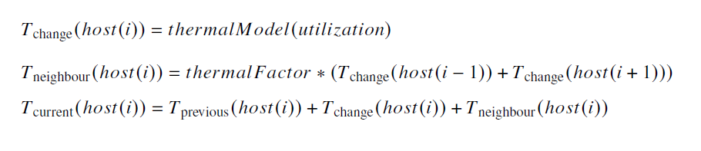
Modelling and Simulation
Modelling:
Host:
The host temperature depends on it’s utilisation and it’s neighbour’s utilization as given below:
Data Center:
The Data center updates the temperature of the host at regular interval as follows:

Slide 5
Modelling and Simulation
Simulation:
The experiment is conducted for a number of simulations. The experiment is done for different number of VM and different rules of cellular automata.
Each simulation is initiated with number of VM and rule for evolving cellular automata.
At start of each simulation, the cellular automata is evolved for finite number of generation and recorded at each generation.
At each optimization of simulation, the states of host is determined by the states of cellular automata in the generation from recording.
After every simulation the energy consumed is observed.

Slide 6
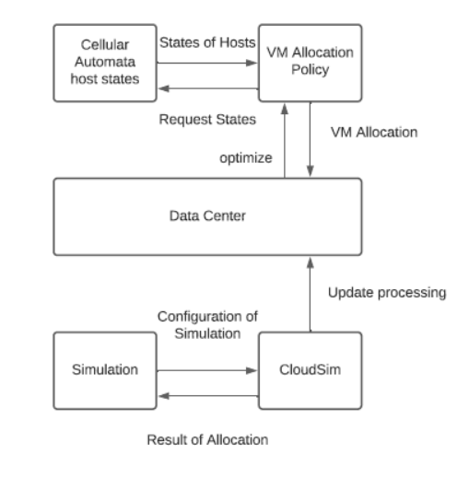
Modelling and Simulation
Architecture Diagram

Slide 7
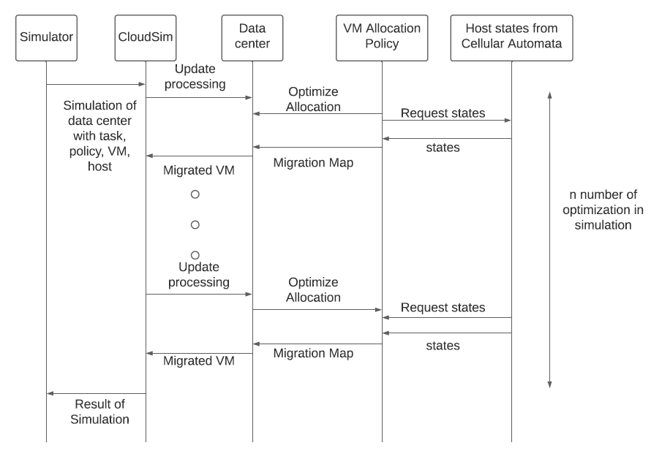
Modelling and Simulation
Sequence Diagram

Slide 8
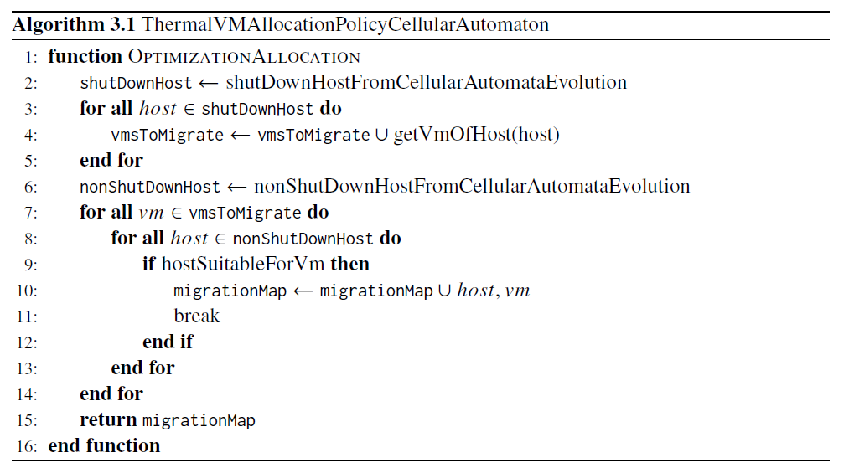
Optimization Algorithm
VM Allocation Policy:
The switched off host at current generation is obtained and the all the VMs from this these host have to be migrated.
The algorithm finds the suitable host for these VMs to be migrated.
The VMs and suitable host is mapped and returned for allocation.

Slide 9
Rule 23 and Rule 232
Rule 23:
The host is switched off, if less than 2 hosts from itself, left and right is switched on, else host is switched on.
Converges to state where it does not change the state in upcoming generation.
Rule 232:
The host is switched off, if more than 1 hosts from itself, left and right host is switched on, else host is switched on.
Forms a pattern.

Slide 10
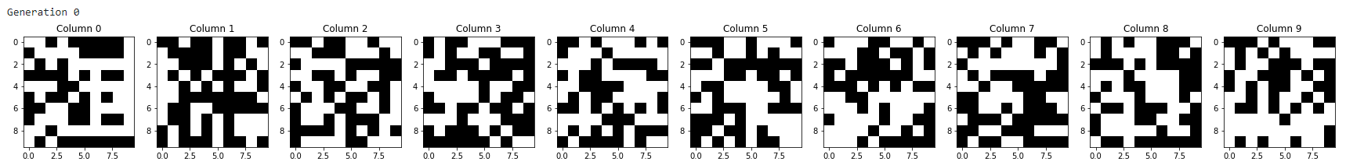
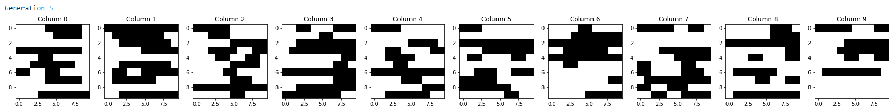

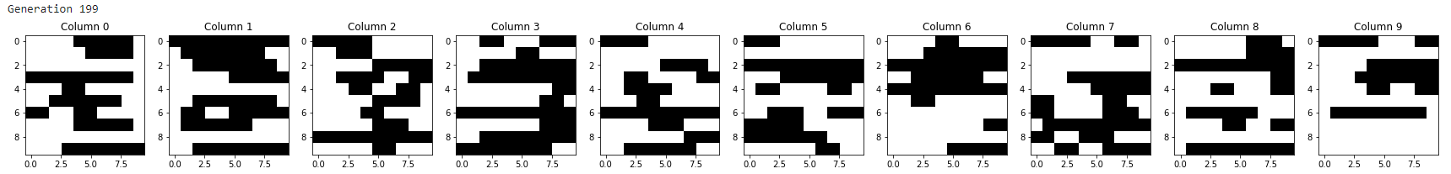
Generations from Rule 23

Slide 11

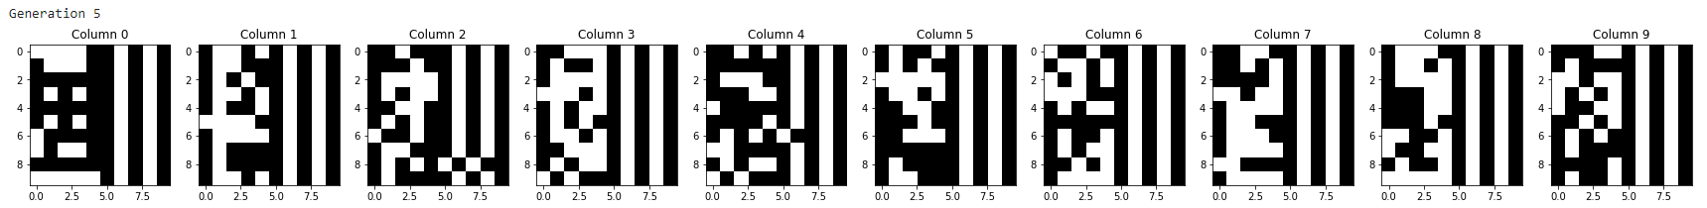
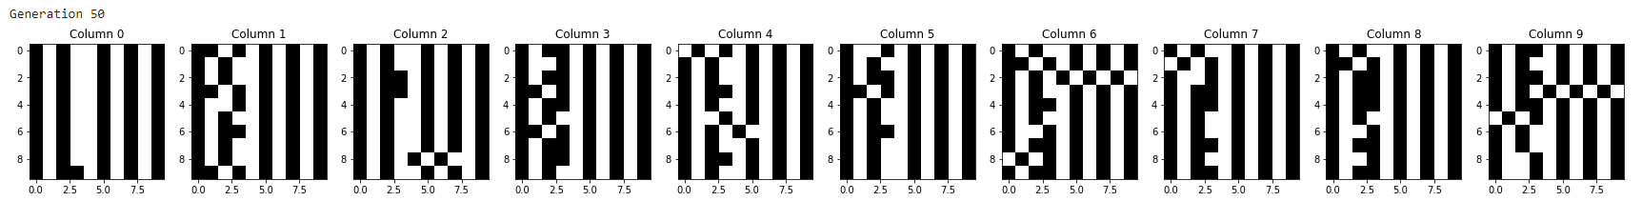
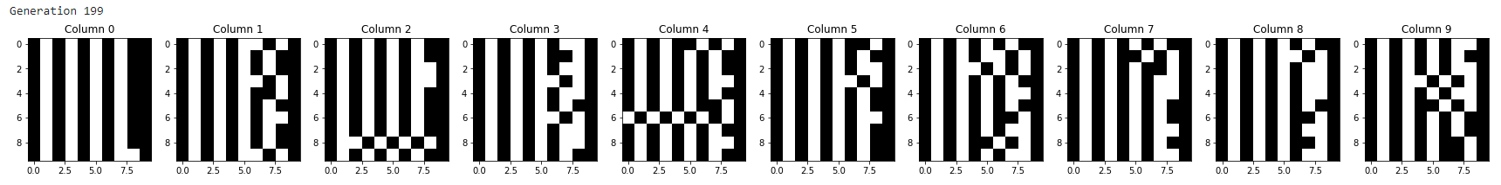
Generations from Rule 232

Slide 12
Wolfram Classification
Classification of rule from rule set when cellular automata and it’s immediate neighbours are used for evolution. The total number of rules for evolution is 255. Some rules from these 255 rule set are classified into four classes as follows:
Class 1: Cellular automata which rapidly converge to a uniform state. Examples are rules 0, 32, 160 and 232.
Class 2: Cellular automata which rapidly converge to a repetitive or stable state. Examples are rules 4, 108, 218 and 250.
Class 3: Cellular automata which appear to remain in a random state. Examples are rules 22, 30, 126, 150, 182.
Class 4: Cellular automata which form areas of repetitive or stable states, but also form structures that interacts with each other in complicated ways. An example is rule 110.

Slide 13
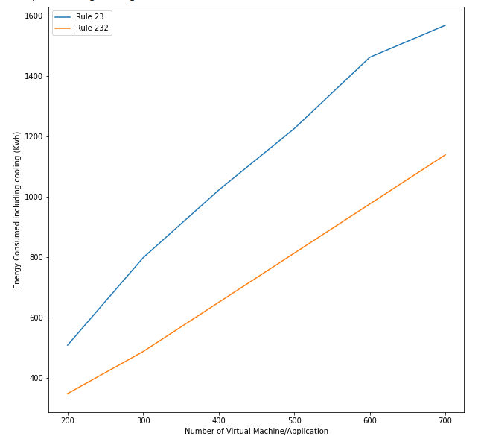
Results
From Rule 23 and Rule 232.

Slide 14
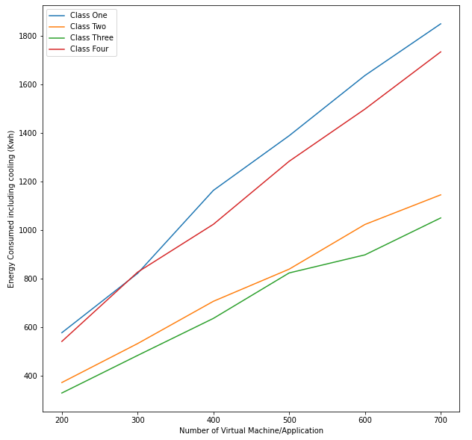
Results
From Wolfram’s rules

Slide 15
Conclusion
The Rule 23 evolution forms a hot spot in the data center by allocating VM in the location where temperature is already high.
The Rule 232 evolution distributes the temperature in the data center by not allocating the VM in the location where temperature is already high.
From the results we can conclude that, when the temperature is distributed in the data center the cooling cost of the data center reduces.
From the results of Wolfram classification graph the order of performance is class 3 > class 2 > class 4 > class 1. However, class 3 remains in random state, so it is not possible say it is better. Therefore from results, we can say class 2 has better performance.

Slide 16
Future Work
Study on performance of rules from different Wolfram’s classes.
Study on relation and performance of rules from same class.
Comparing cellular automata resource allocation result from other related works.

Slide 17
References
V. D. Reddy, B. Setz, G. S. V. R. K. Rao, G. R. Gangadharan and M. Aiello, "Metrics for Sustainable Data Centers," in IEEE Transactions on Sustainable Computing, vol. 2, no. 3, pp. 290-303, 1 July-Sept. 2017, doi: 10.1109/TSUSC.2017.2701883.
Goyal, Tarun Singh, Ajit Agrawal, Aakanksha. (2012). Cloudsim: Simulator forcloud computing infrastructure and modeling. Procedia Engineering. 38. 3566-3572.10.1016/j.proeng.2012.06.412.
Q. Tang, S. K. S. Gupta and G. Varsamopoulos, "Thermal-aware task scheduling for data centers through minimizing heat recirculation,"2007 IEEE International Conference on Cluster Computing, Austin, TX, 2007, pp. 129-138, doi: 10.1109/CLUSTR.2007.4629225.
Mhedheb Y., Jrad F., Tao J., Zhao J., Kołodziej J., Streit A. (2013) Load and Thermal-AwareVM Scheduling on the Cloud. In: Kołodziej J., Di Martino B., Talia D., Xiong K. (eds) Algorithms and Architectures for Parallel Processing. ICA3PP 2013. Lecture Notes in Computer Science, vol 8285. Springer, Cham. https://doi.org/10.1007/978-3-319-03859-9_8.
Dinesh Reddy, V., Gangadharan, G.R. Rao, G.S.V.R.K. Energy-aware virtual machine allocation and selection in cloud data centers. Soft Comput 23, 1917–1932 (2019). https://doi.org/10.1007/s00500-017-2905-z.

Slide 18
References
Sukhpal Singh Gill, Shreshth Tuli, Adel Nadjaran Toosi, Felix Cuadrado, Peter Garraghan, Rami Bahsoon, Hanan Lutfiyya, Rizos Sakellariou, Omer Rana, Schahram Dustdar, Rajkumar Buyya, ThermoSim: Deep learning based framework for modeling and simulation of thermal-aware resource management for cloud computing environments, Journal of Systems and Software, Volume 166, 2020, 110596, ISSN 0164-1212, https://doi.org/10.1016/j.jss.2020.110596. (http://www.sciencedirect.com/science/article/pii/S0164121220300753).
Z. Chen, J. Hu and G. Min, "Learning-Based Resource Allocation in Cloud Data Center usingAdvantage Actor-Critic,ÏCC 2019 - 2019 IEEE International Conference on Communications(ICC), Shanghai, China, 2019, pp. 1-6, doi: 10.1109/ICC.2019.8761309.
M. Ghosh, R. Kumar, M. Saha and B. K. Sikdar, "Cellular Automata and Its Applications,"2018 IEEE International Conference on Automatic Control and Intelligent Systems (I2CACIS), Shah Alam, 2018, pp. 52-56, doi: 10.1109/I2CACIS.2018.8603689.
Martinez, Genaro J. & Seck Tuoh Mora, Juan & Zenil, Hector. (2012). Wolfram's Classification and Computation in Cellular Automata ClassesIII and IV. 10.1007/978-3-642-35482-3_17.

Slide 19
Thank you!

